Slide 1
Visualizations in Excel
Spring Semester 2020
Notes:
About me
- Kimberly Rubens, Second year Goldman School of Public Policy Student
Excel enthusiast – also available as a consultant via D-Lab for an individual Excel related questions
Fun fact:

Slide 2
Agenda
Basics of Visualization
Clustered Bar Graphs
Pie Charts
Slopegraphs
Benchmark Line
Butterfly Graphs
Stacked Bar Graph
Confidence Intervals
Time Stamp Line
Icon Arrays

Slide 3
This class is not for a scholarly audience
Notes:
This class focuses on creating and formatting graphs for reports and presentations. You can create academic visuals – for papers or conferences – in Excel, or in other software, but your best practices may differ from the ones in this class.

Slide 4
Excel and PowerPoint are powerful tools…

Slide 5
Excel and PowerPoint are powerful tools…

Slide 6


…but they’re not the only tools
Interactive Dashboards | Reports or other static documents
Constantly Updating Data | Data isn’t constantly updated
Trying to create online tool | Need to make a few quick charts
Notes:
UC Berkeley students can download & use Tableau Desktop for free.

Slide 7
How you present information matters

Slide 8
How you present information matters

Slide 9
Formatting Basics in Excel
Insert | Page Layout | Chart Design | Formatting Sidebar
Where you insert a chart into workbook | Where you change design colors. NEVER USE EXCEL PRESET COLORS | Where you can change the type of chart | Where you can use Excel witchcraft to make visualizations that are aesthetically pleasing while retaining intellectual integrity

Slide 10



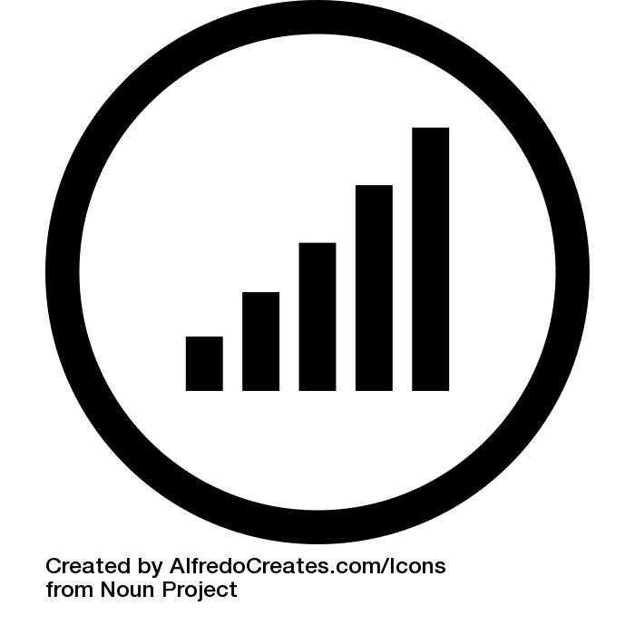
Kimberly’s Visualization Checklist
Do the colors make sense?
Are the colors not red and green?
Did I use a tasteful (~3) amount of color?
Have I refrained from using weird fading options?
Is the text professional?
Is there a title?
If possible, is the title active?
Is there a short descriptive sentence?
Is everything grammatically correct?
Is it well aligned?
Are the numbers big enough to read?
Are my units labeled if necessary?
Is there a comparison?
Is that comparison clear?
Have I deleted unnecessary grid lines?
Is my data sourced in the bottom right or left hand corner?
Notes:
On color choice – sometimes gradients make sense (e.g. to show a spectrum or pattern), sometimes a contrasting color makes sense
An active title helps advance the position or point made by your graph – depending on the graph, this isn’t always possible, but at the very least your title should be concise and relevant

Slide 11
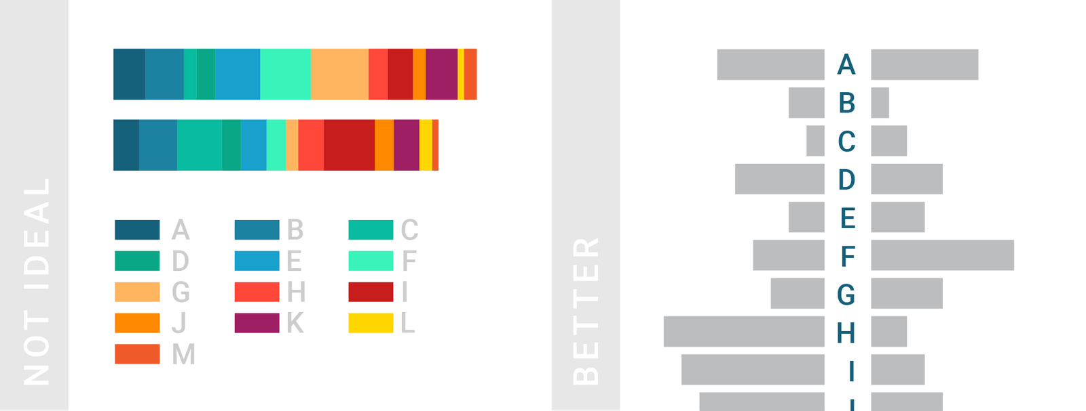
On color choice…
Source: https://www.dataquest.io/blog/what-to-consider-when-choosing-colors-for-data-visualization/

Slide 12
Kimberly’s Visualization Checklist
Notes:
Text: Title short, check
Text: Short active descriptive sentence, check
Data: sourced, check
Data: comparison

Slide 13
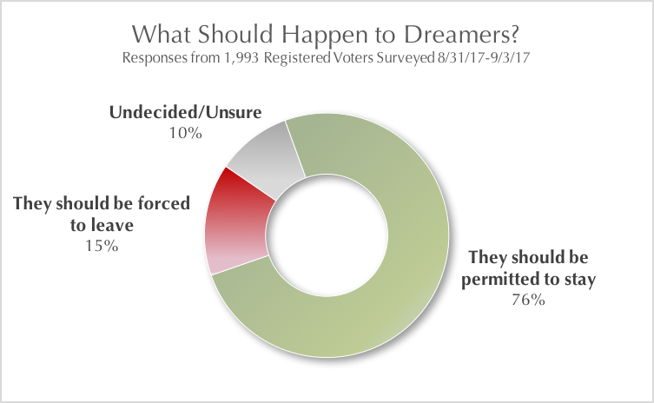
Do not…use weird fading options
Notes:
Not sourced, used red and green, weird fading options, title is good but isn’t enough contrast, data isn’t aligned at 0%

Slide 14
Do not…use 3-d Excel graphs
Notes:
Basically: avoid visual elements that don’t say anything about the data.

Slide 15
Most importantly…DO NOT USE EXCEL PRESETS

Slide 16
Visualization – Graphing by Data Type
Type of Data | Try This!
Comparison (2 numbers) | Doughnut Pie Graph!
Comparison 2 sets of data | Slope-graph
Benchmark / Relative Performance | Bar graph with benchmark line
___ out of ___ people say ____ | Use graphics from Icon Array PowerPoint or other graphic resource
Comparing data of 2 groups of people | Butterfly graph
Survey Data | Stacked Bar Graph
Statistical Data | Graph with Confidence Intervals

Slide 17

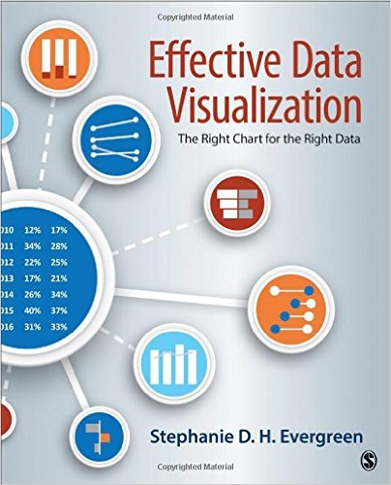
My Favorite Resources
Anything by Edward Tufte
Patty Frontiera’s D-Lab Class
Stephanie Evergreen’s Effective Data Visualization & Presenting Data Effectively

Slide 18
Agenda
Basics of Visualization
Clustered Bar Graphs
Pie Charts
Slopegraphs
Benchmark Line
Butterfly Graphs
Stacked Bar Graph
Confidence Intervals
Time Stamp Line
Icon Arrays

Slide 19
Clustered Bar Graph: Before

Slide 20
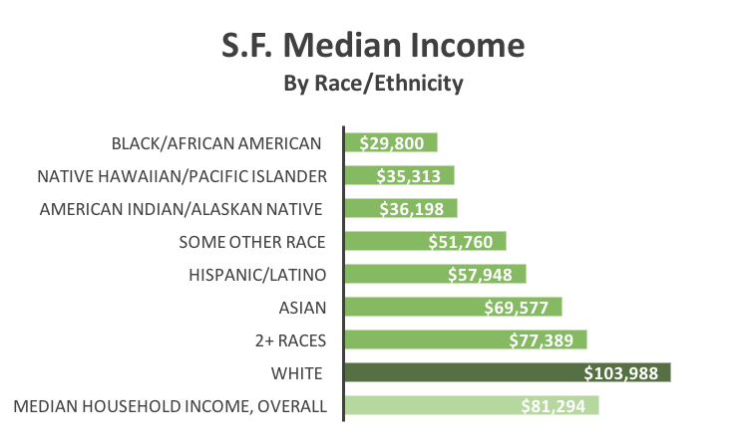
Clustered Bar Graph: After

Slide 21
Clustered Bar Graph Instructions
1 | Select the design colors you would like to use under the ”Page Layout” tab. I like “Blue Warm.”
2 | Select the data A3:B11 in the workbook, don’t forget keyboard shortcuts!
3 | On the Excel Ribbon, go to Insert tab, select the first chart this is recommended, ”Clustered Bar Graph”
4 | Give your chart a title, make the text darker
5 | Delete the vertical lines (highlight them, and hit delete), x-axis labels (Format chart→Format axis→Labels)
6 | Sort your data: select A3:B11, click the sort button under the data tab, choose column B, “largest to smallest”
7 | Under Chart Design, use the “Add Chart Element” dropdown menu to add a data label to your chart, choose inside end Highlight the series, click “Add Data Labels”, then format the labels once added
8 | Change the color of the text of the Data Label by clicking one of the numbers, and using the tools available under “Text Options” that pops up on the right hand side
9 | Make the y-axis labels bigger, change the y-axis font
10 | Make the bar separating the y-axis labels and stacked bars thicker: click on the y-axis labels, under the paint can tab, play around with the solid line formatting features under the tab “line”
11 | Make the horizontal bars bigger by changing the “Gap width,” it is the third tab on the ”Format Series” toolbar that pops up
12 | Change the color of the Median Income bar by clicking twice on that bar.
Notes:
Eyedropper
Selecting Design Colors / Excel Colors
Double clicking w/in a chart is your best friend

Slide 22
Agenda
Basics of Visualization
Clustered Bar Graphs
Pie Charts
Slopegraphs
Benchmark Line
Butterfly Graphs
Stacked Bar Graph
Confidence Intervals
Time Stamp Line
Icon Arrays

Slide 23
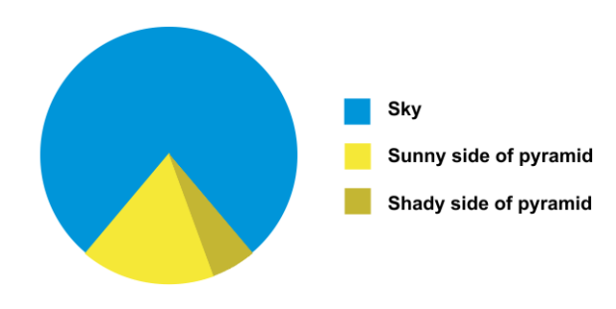
Pie Charts
Notes:
Never to be used for a scholarly audience. Only for two pieces of information – mainly to highlight a disparity between the two, Sometimes you can use three data points

Slide 24
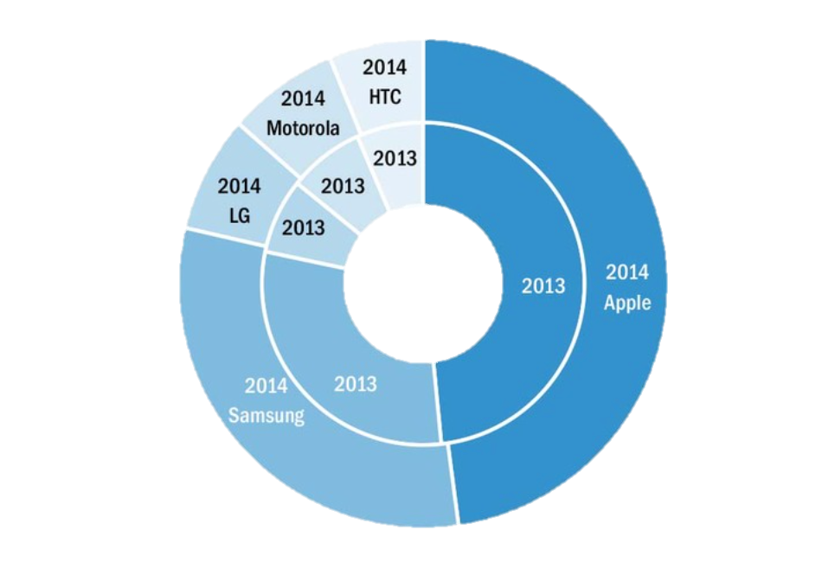
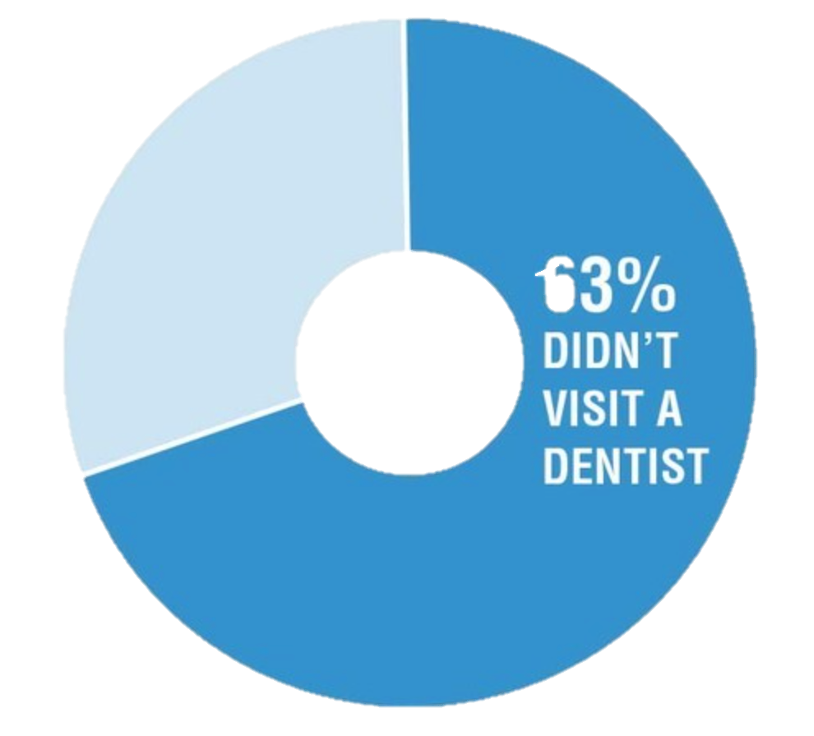
Pie Charts
Effective Data Visualization, Evergreen, p.15
Notes:
Should only be used to highlight one number (hard to get meaningful information otherwise)

Slide 25
Pie Chart Instructions
1 | Select design colors under the ”Page Layout” tab. If you change the design colors in one sheet it’ll change the design colors in the whole workbook.
2 | Select all the data in the workbook, A9:B10, don’t forget keyboard shortcuts!
3 | On the Excel Ribbon, go to Insert tab, select pie image, then doughnut
4 | Reduce the doughnut hole size by double clicking on the ring, then reducing the percentage of the donut hole.
5 | Add a chart title, make sure it’s clear and active if possible
6 | Remove the border of the donut by toggling over to the paint can while the sidebar says “Format Data Series” and check “no line” under “Border”
7 | Delete the legend entry
8 | Add a textbox. Feel free to write “97% of respondents thought Kimberly’s first class last semester was spectacular!”
9 | Add data label to the pie chart by right clicking on the pie chart then selecting data labels
10 | Format data labels by using Excel formatting tools for text size and color under the home tab
11 | Format chart title so that it’s no longer grey. Also right or left align your title. The Excel default for titles is to use grey which is ugly and not helpful for legibility purposes. You can format the title text by using the formatting options under the home tab. Don’t forget to make sure the text is professional and legible

Slide 26
Agenda
Basics of Visualization
Clustered Bar Graphs
Pie Charts
Slopegraphs
Benchmark Line
Butterfly Graphs
Stacked Bar Graph
Confidence Intervals
Time Stamp Line
Icon Arrays

Slide 27
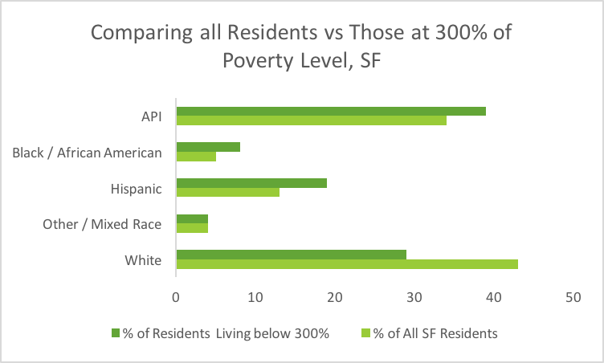
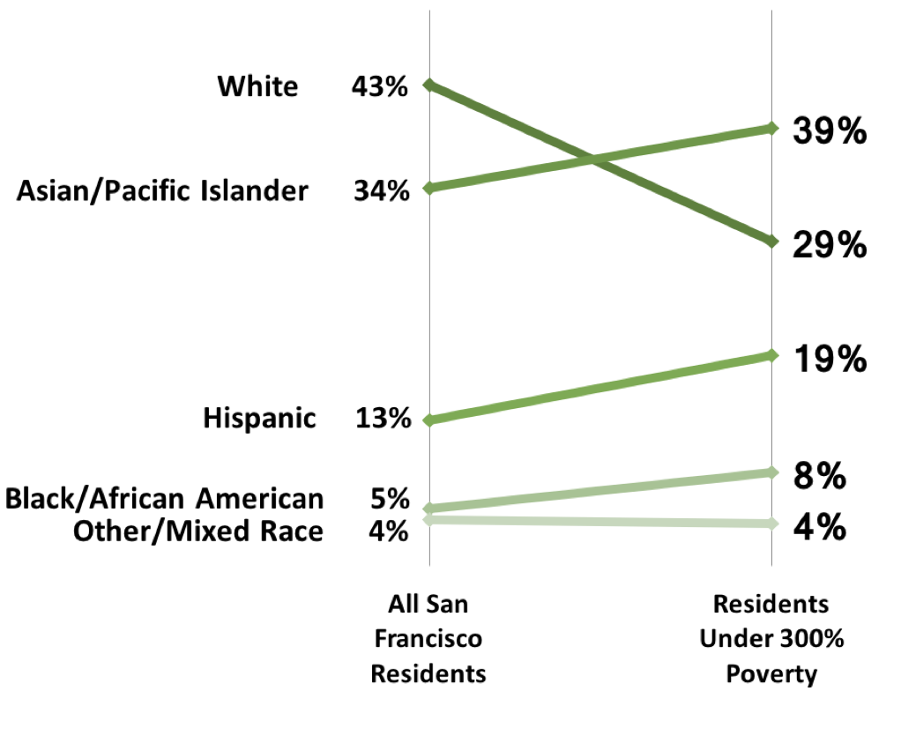
Slopegraphs
Notes:
Slopegraphs are good for comparing two values – often a time series.

Slide 28
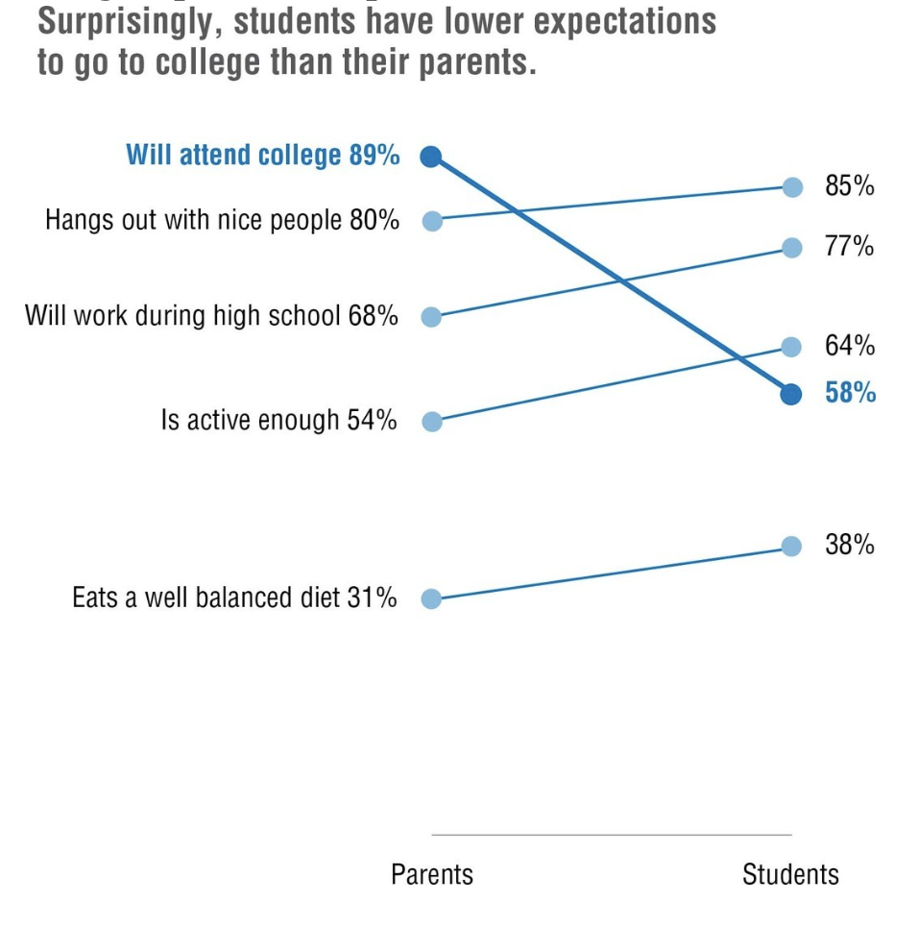
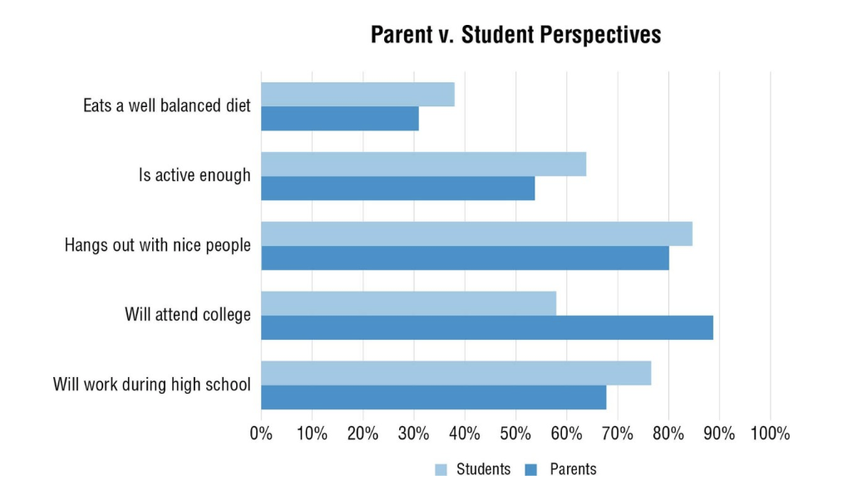
Slopegraphs

Slide 29
Slopegraph Instructions
Select design colors under the ”Page Layout” tab.
Put data into right format: two columns next to each other with numbers
Highlight Rows and Columns: A5:C10 ** don’t include Row 4**
Insert Line Graph – Make sure you’re picking “Line with Marker”
Click “Switch Row/Column” button (Right click on chart, pick “Select Data”, the button should appear)
Right click or double click on x-axis to bring up the Format Axis Toolbar
Select “Axis Options” → “Axis Position” → “On Tick Marks”
Delete y-axis & legend labels & y-axis gridlines
Increase the width of each line to 4pt under “Fill & Line” → “Border” → “Width”
Decrease the size of the “Plot Area,” Make the X-Axis labels bigger
Get rid of the outline around your graph Click on the Format Tab, find the pencil icon next to the paint can button Click on the button and select no outline

Slide 30
Slopegraphs – Adding Data Labels
Right click on the first line, click add data label
Make the font of both labels the same color as the line
Delete the left data label, make sure that you only have the left one selected
Add a text + data label for each line Insert a text box Type the text descriptor + the 2008 number, so for example the first text box should read “Black or African American, 457”
4. Or, right click on the line, pick “Format Data Labels”, and under label options, check “Series Name” Make sure the data labels and text box font color match the line of your graph
Repeat steps 1 – 5 four more times.
You can do it!

Slide 31
Agenda
Basics of Visualization
Clustered Bar Graphs
Pie Charts
Slopegraphs
Benchmark Line
Butterfly Graphs
Stacked Bar Graph
Confidence Intervals
Time Stamp Line
Icon Arrays

Slide 32
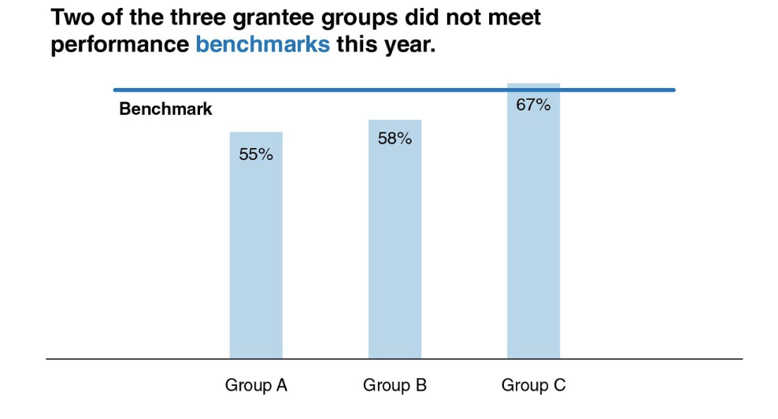
Benchmark Data

Slide 33
Benchmark Data Instructions
1 | Select design colors under the ”Page Layout” tab.
2 | Select A4:C11
3 | Insert a clustered column graph
4 | Let’s transform these clustered columns into a benchmark line! Right click on one of the 51% columns Toggle over to ”Change Series Chart Type” For Series2 (which corresponds with the 51% bars), select ”Line”. Click OK
5 | Delete the contents of cells A4 and A11
8 | Formatting Delete the y-axis label, horizontal gridlines, legend labels Expand your chart area so that all the text for the x axis labels is legible Give your chart a title Add data labels that show the percentage of votes received by each proposal, as well as the benchmark percentage

Slide 34
Agenda
Basics of Visualization
Clustered Bar Graphs
Pie Charts
Slopegraphs
Benchmark Line
Butterfly Graphs
Stacked Bar Graph
Confidence Intervals
Time Stamp Line
Icon Arrays

Slide 35
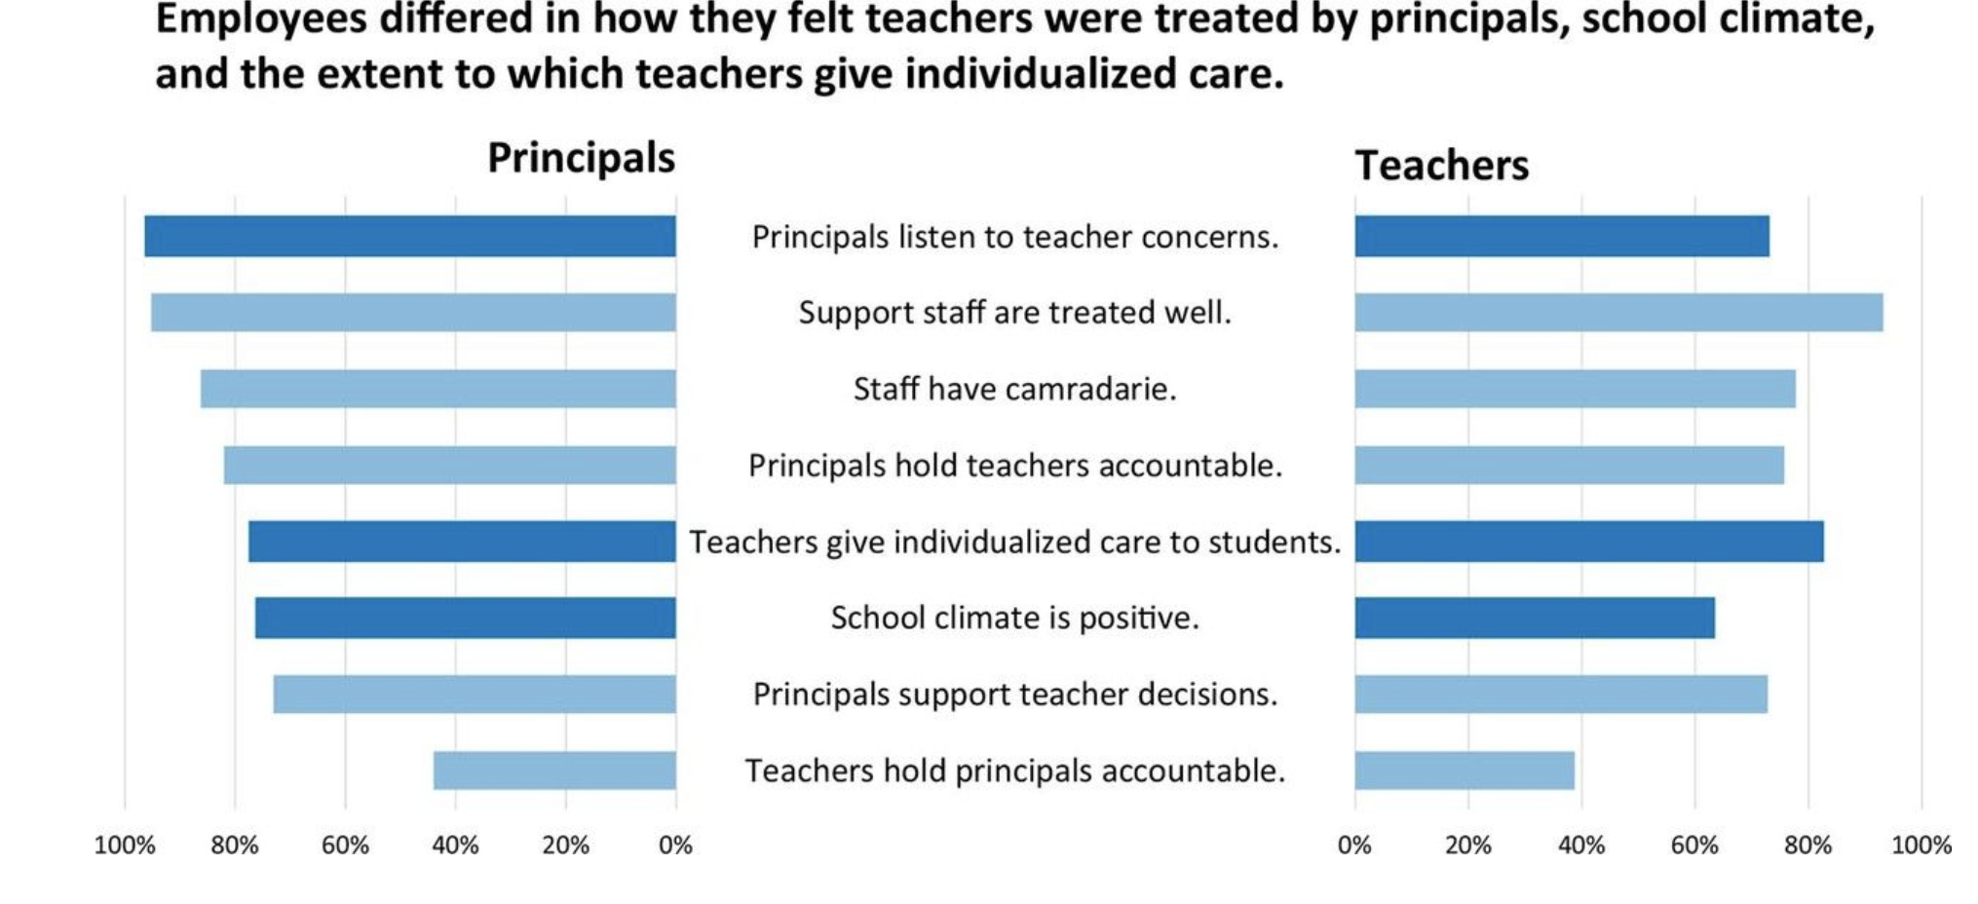
Butterfly Graphs
Source: Evergreen, “Effective Data Visualization” p.48

Slide 36
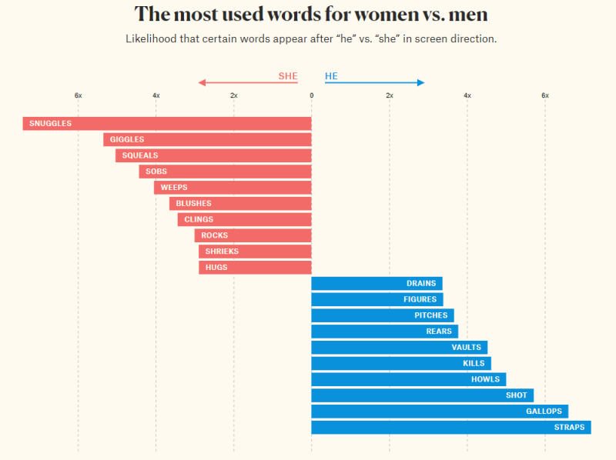
Butterfly Graphs

Slide 37
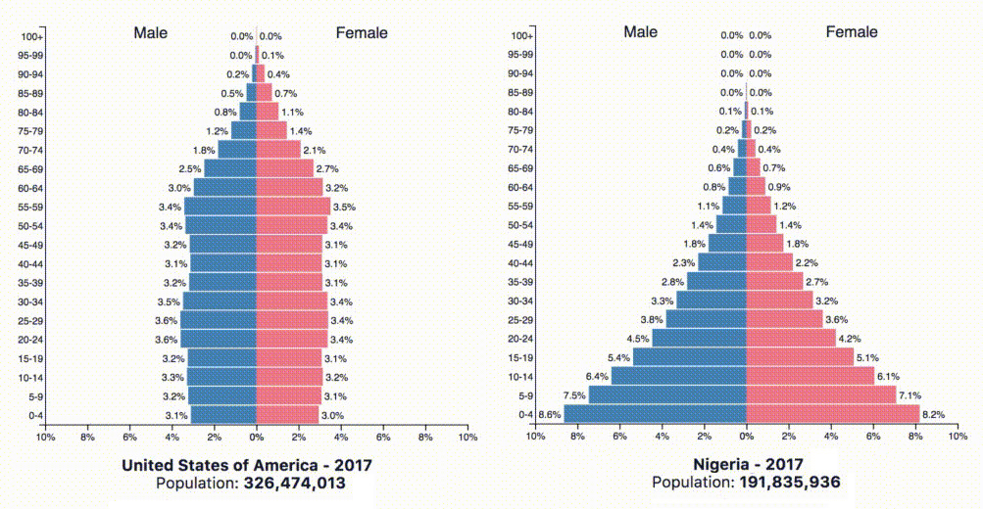
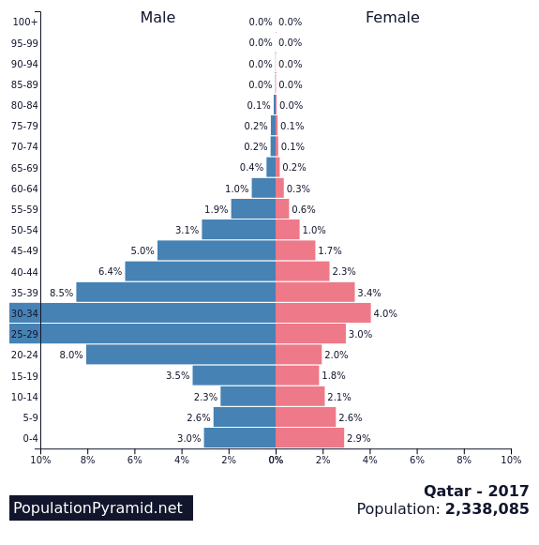
Butterfly Graphs

Slide 38
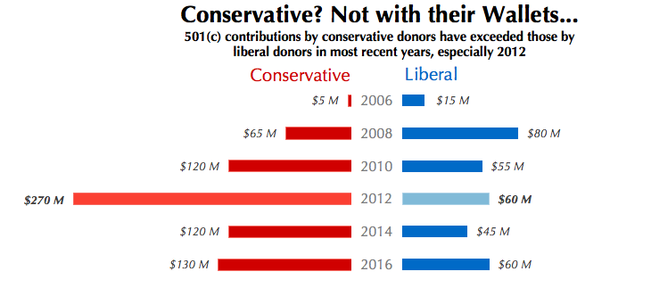
Butterfly Graphs

Slide 39
Butterfly Graph Instructions
1. Start with your data in three columns: common index, group 1, group 2
2. Make a clustered bar graph with Conservative Data (B3:B9)
3. We want to flip the Conservative clustered bar graph Right click on x-axis, select “Format Axis” Under Axis Options (the graph icon), select “Values in Reverse Order”
4. Insert clustered bar graph of Liberal Data (C3:C9)
5. We need to fix the axis on our Liberal Data Right Click on x-axis, select “Format Axis” Change the maximum bound to 300
6. Delete both y-axes
7. We will now do the rest of our formatting in PowerPoint Copy and paste both charts into the PowerPoint slide labeled “Butterfly Graph Practice”
8. To make sure both graphs are aligned select both charts by first holding either CTRL or CMD button and then selecting Go to the shape format tab Click the Align button and select “Align Top” On the Home tab, select “Arrange” and then “Align” and then “Align Top”

Slide 40
Butterfly Graph Formatting Tasks
1. Delete the y-axis labels
2. Insert a text box for each year Hint: you can replicate a text box by selecting it, then pressing control and dragging it Then you can align them horizontally when you’re done making them
3. Remove the lines of your graphs + the text boxes by Right Clicking, bringing up the formatting box, then going to “Chart Options” → “Fill & Line” → “Border” → select “No line”
4. Remove the x-axis lines
5. Add data labels by selecting the bars of one graph, go to the Chart Design tab, “Add Chart Element” → “Data Labels” →
6. Pick a neutral color for each set of bars, red for conservatives (republicans) and blue for liberals (democrats)
7. Pick a stand out color for each bar for year 2012. You’re trying to highlight that 2012 was a cray year for campaign spending.
8. Add a good title.

Slide 41
Butterfly practice space

Slide 42
Other options for making butterfly (or tornado) charts:
Population Pyramid template:
https://www.measureevaluation.org/resources/training/capacity-building-resources/m-e-of-malaria-programs-1/data-demand-and-use-population-pyramid-template/view
Tornado chart how-tos
https://www.excelhowto.com/how-to-create-tornado-chart-butterfly-chart/
https://www.excelhowto.com/how-to-use-clustered-bar-to-create-tornado-chart/

Slide 43
Agenda
Basics of Visualization
Clustered Bar Graphs
Pie Charts
Slopegraphs
Benchmark Line
Butterfly Graphs
Stacked Bar Graph
Confidence Intervals
Time Stamp Line
Icon Arrays

Slide 44
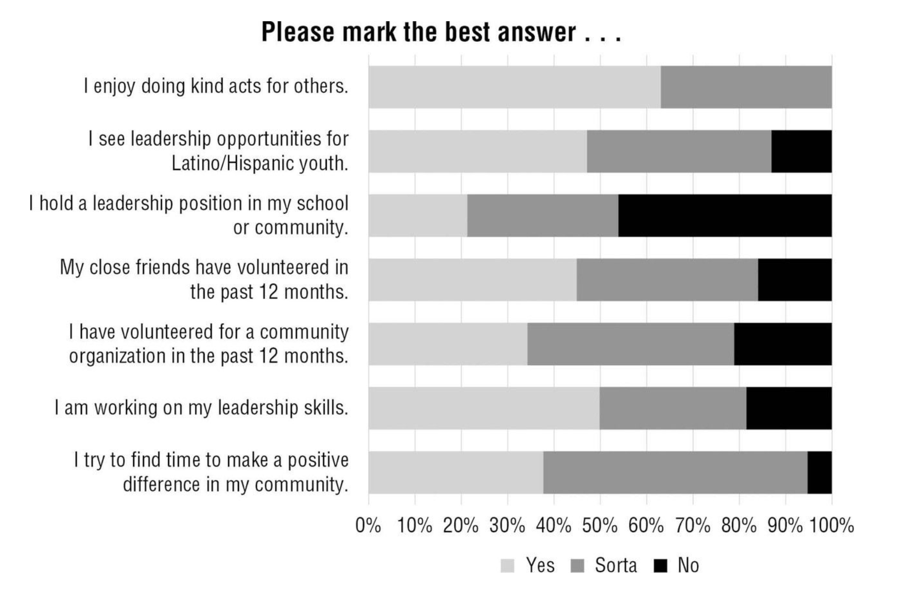
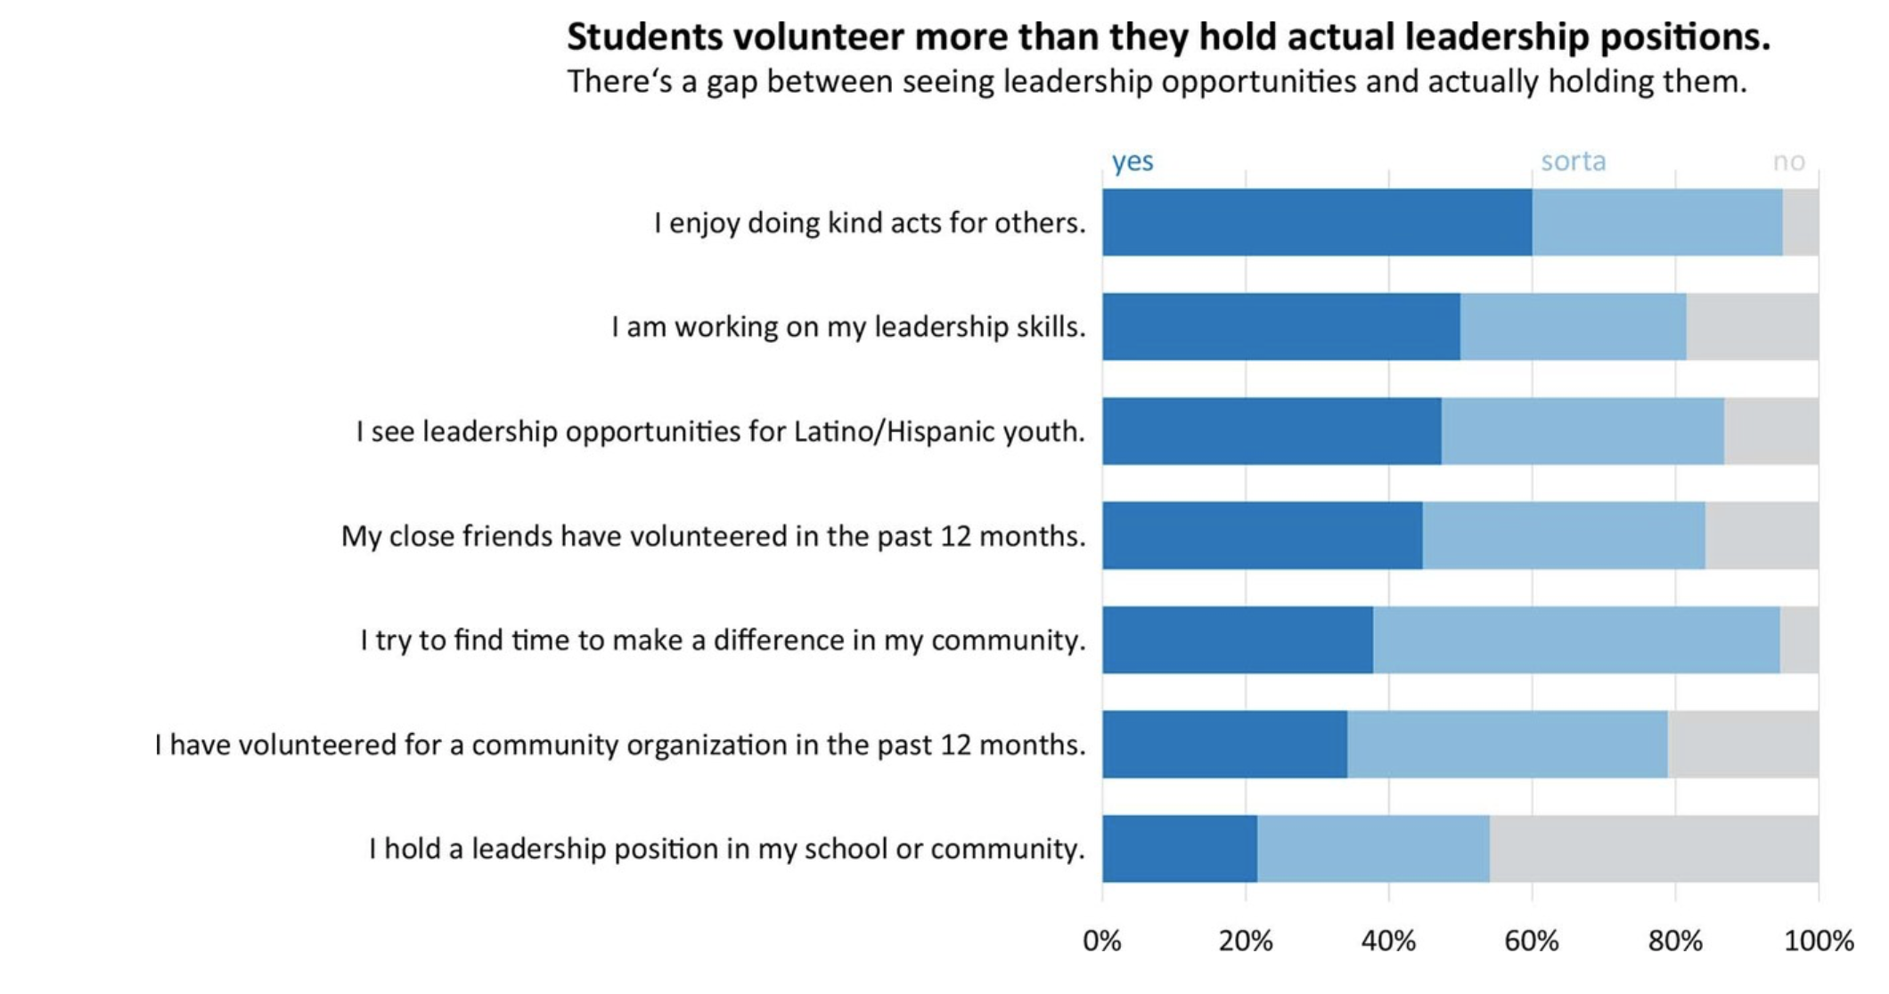
Stacked Bar Graphs
Source: Evergreen, “Effective Data Visualization” p.104-105
Notes:
The alternative to a stacked bar graph is often a clustered bar or column chart, which can allow you to compare values within each category as well as within each response. Stacked bar graph allow you to compare proportions within a category.
What’s better about the graph on the right?

Slide 45
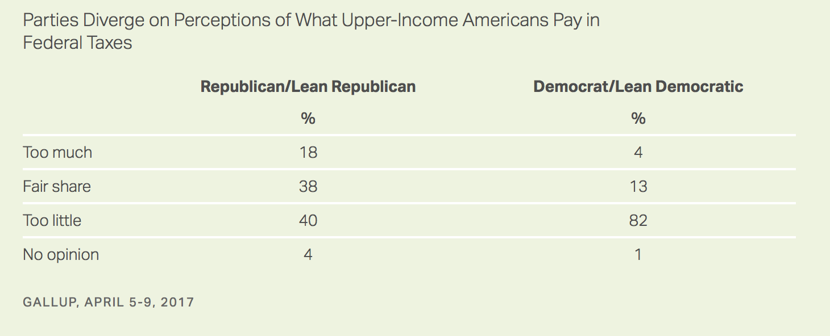
Stacked Bar Graphs
Full Article

Slide 46
Stacked Bar Graphs
Full Article

Slide 47
Stacked Bar Graph: The Basics
Select A4:C8
Insert Stacked Bar graph
Wait! This doesn’t look right, we’re trying to understand Democrats v Republicans Under “Chart Design” tab, select the button that says “Switch Row/Column”
Add an active title, you can use the Gallup title, but it’s a little cumbersome
Delete y-axis gridlines
Darken the font of the title – Excel always chooses a light font, it’s v annoying.
Darken the y-axis line at the 0 (Hint: Need to select the y-axes labels, then find the paint can icon in the formatting menu.)

Slide 48
Stacked Bar Graph: Formatting
Sort the data based on the information you’re trying to pull out The biggest difference here is that Republicans and Democrats have wildly different views on whether or not Upper-Income Americans pay too little in taxes Select A5:C8 & click on the sort button Under Column, select Democrat / Lean Democrat Under Order, select Largest to smallest, hit Ok
Pick a new color scheme I like monochromatic, but the “Change Colors” feature sometimes isn’t enough contrast, if that’s the case then do the following: For ”Too Little” select a dark color Make “Fair Share” and “Too Much” lighter versions in the same column Make “No Opinion” a light grey
The legend is ugly, let’s delete it then make new labels using linked text boxes Insert a text box above the portion of the bar delineating “too little” In the formula bar (fx) type “=”, then select cell A5 Make the font match the color of the bar
Repeat the same steps above for the label “Fair Share”

Slide 49
Agenda
Basics of Visualization
Clustered Bar Graphs
Pie Charts
Slopegraphs
Benchmark Line
Butterfly Graphs
Stacked Bar Graph
Confidence Intervals
Time Stamp Line
Icon Arrays

Slide 50

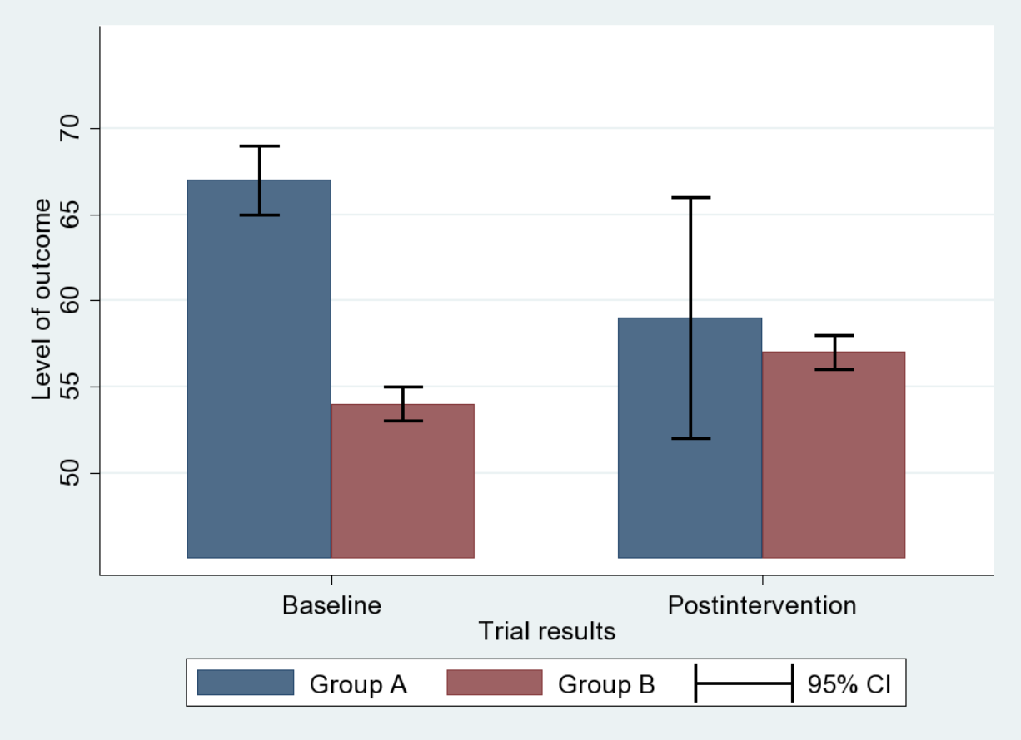
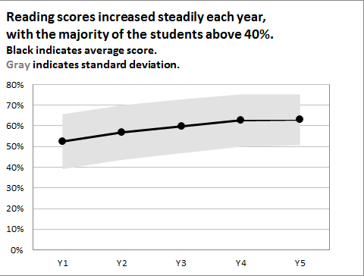
Confidence Intervals
Source: Evergreen, “Effective Data Visualization” p.30
Notes:
Using bars for ranges: can be good at showing overlap between categories (if you have discrete categories)
Using shaded confidence interval: can show uncertainty over a continuous dataset
Other ways to represent uncertainty in data (other than confidence intervals): showing data distributions through histograms

Slide 51
Confidence Interval Instructions – Part 1
Select A8:C11 A8:B11
Insert Line Graph (with markers) Insert clustered column graph
We’re going to delete the line of the program results (trust me) Double click anywhere on the line that shows the results data Under the paint can icon, select “no line” Also toggle to markers– select no fill, no line
Let’s make our program markers bigger Toggle over to markers Select “Built in” under “Marker Options” Change the size to 10, and the type if you please
Let’s fix the y-axis Select the y-axis, toggle over to the chart icon Change maximum bound from 0.8 to 1.0
Let’s make the y-axis labels in percents In the same dialogue box, expand the “Number” heading Change the category from general to percentage Change the decimal places number from 2 to 0

Slide 52
Confidence Interval Instructions – Part 2
We’re now going to add error bars, aka confidence intervals
Select one of the results icons so that the Chart Design tab pops up, click on it.
At the very far left of the tab, click the button that says “Add chart element”
Toggle down to error bars, and select “more error bar options”
Make sure that you’re in the tab under format options with the graph icon Under Error Amount, select custom, and click on the button that says specify value A dialogue box will pop up called “Custom Error Bars”
In the “Custom Error Bars” box [IMPORTANT– DO THIS BY CLICKING ON THE ICONS] Positive Error Value: select D8:D11 Negative Error Value: select D8:D11 Click ok Then, to see the error bars, format the data series to have solid fill, and adjust transparency

Slide 53
Agenda
Basics of Visualization
Clustered Bar Graphs
Pie Charts
Slopegraphs
Benchmark Line
Butterfly Graphs
Stacked Bar Graph
Confidence Intervals
Time Stamp Line
Icon Arrays

Slide 54
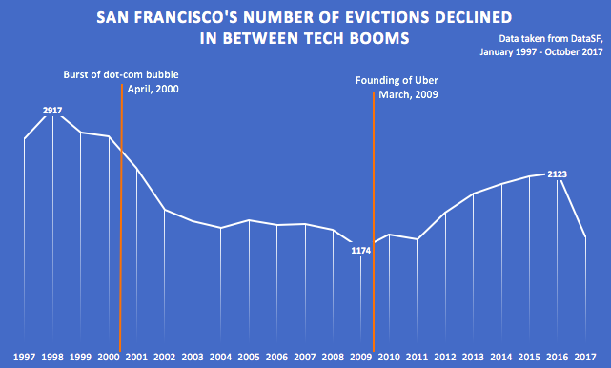
Time Stamps

Slide 55
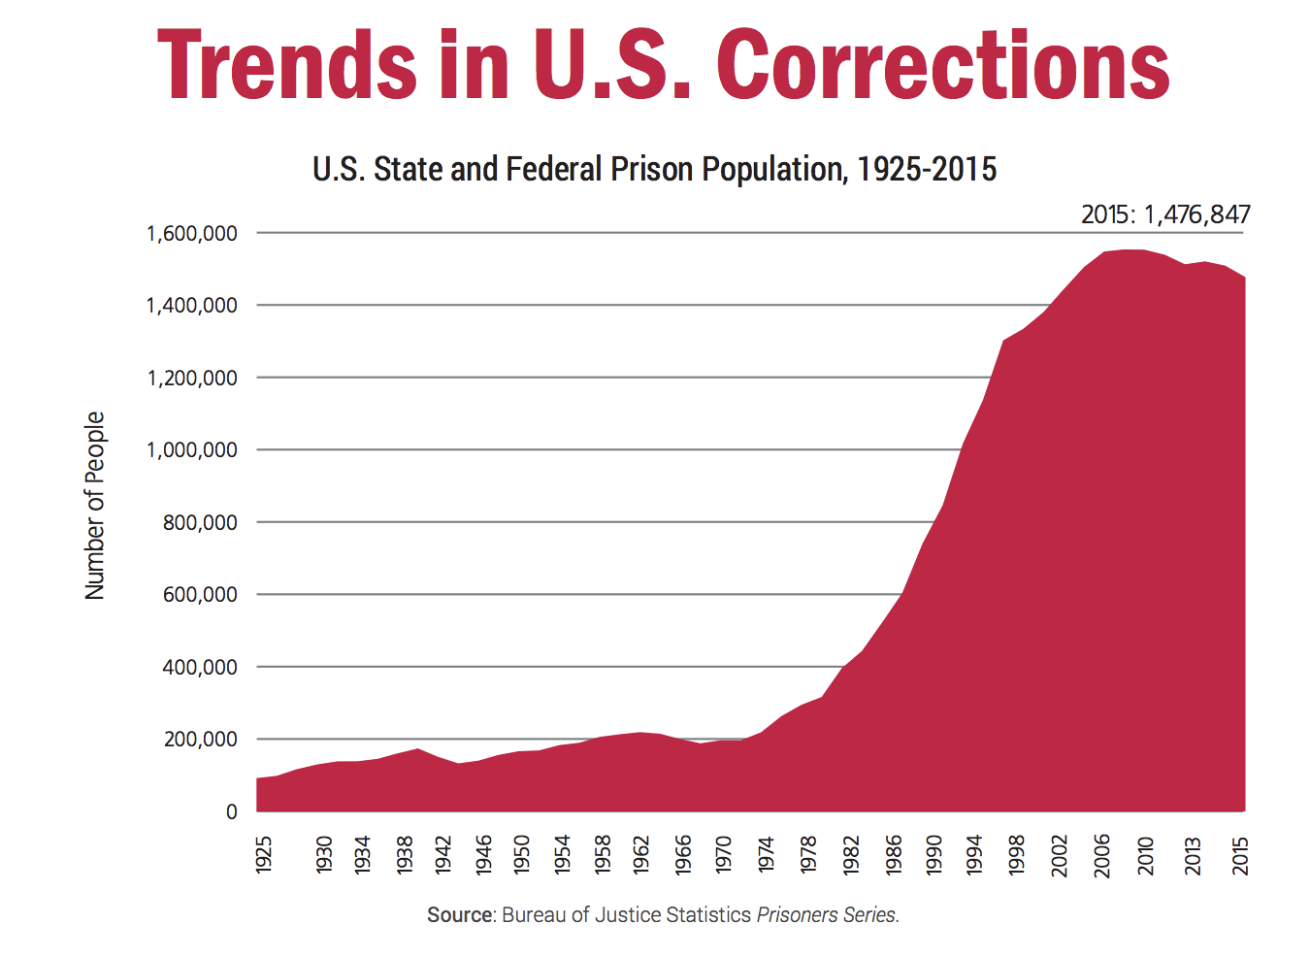
Time Stamps

Slide 56
Time Stamp Instructions
Draw a line under the insert tab Select the line under the shapes button Eyeball where it should go
Formatting trick – let’s change x-axis labels to show years (if it doesn’t already( Right click on x-axis labels Click select data Where it says Horizontal (Category) axis labels, select cells A2:A7 Press ok To figure out where to place the time stamp line exactly, we can add more tick marks on the x-axis Double click on the x-axis labels Under the chart icon in format axis, navigate to Axis Options Under Axis Type, select “Date Axis” Now the graph will show dates at a higher resolution – you can place the line in the correct location

Slide 57
Agenda
Basics of Visualization
Clustered Bar Graphs
Pie Charts
Slopegraphs
Benchmark Line
Butterfly Graphs
Stacked Bar Graph
Confidence Intervals
Time Stamp Line
Icon Arrays

Slide 58
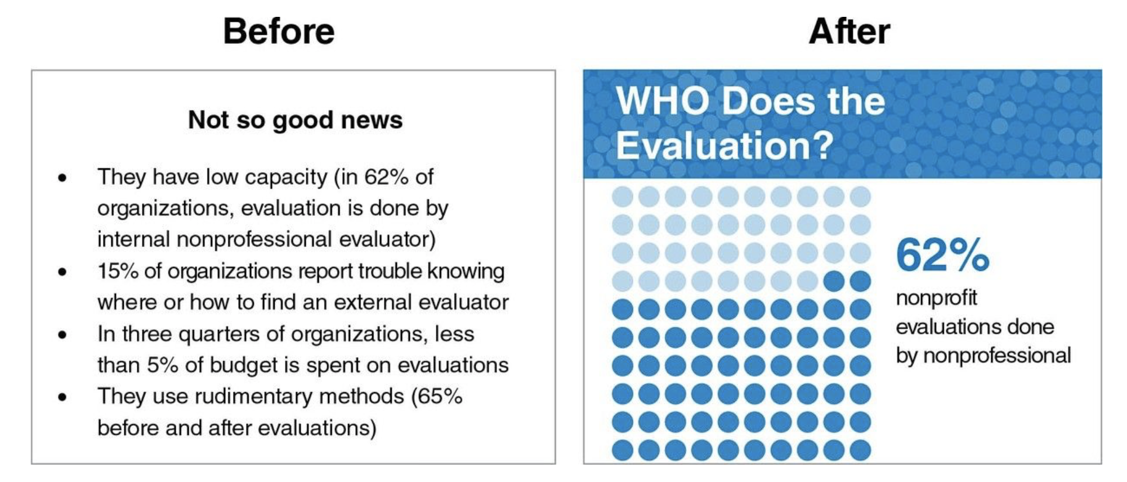
Icon Arrays
Source: Evergreen, “Effective Data Visualization” p.14
Notes:
I’ve found an interesting gallup article about media perceptions around the world that we’ll be using for our practice. HOWEVER, I have not spent time in the methodology of these results so I cannot speak to their validity, this is solely a class exercise. They provide complete methodology online

Slide 59
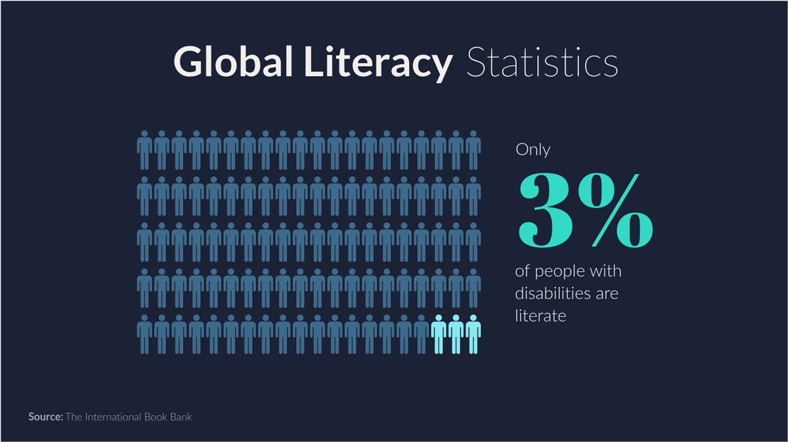
Icon Arrays - Examples
http://blog.visme.co/pictograph-maker/
Notes:
Example of what I like
Only one graphic

Slide 60
Icon Arrays - Examples
Notes:
Example of what I don’t like
Too many colors
Icons are distracting, I would split up these statistics, or maybe choose different icons

Slide 61
Icon Arrays
Statistic we want to turn into an icon array:
In 2015, 60% of Georgians polled answered ’yes’ to the following question: Do the media in this country have a lot of freedom, or not?
Data Source
Notes:
I’ve found an interesting gallup article about media perceptions around the world that we’ll be using for our practice. HOWEVER, I have not spent time in the methodology of these results so I cannot speak to their validity, this is solely a class exercise. They provide complete methodology online

Slide 62
Icon Arrays
Select the icon you want to use ** we’re working in the Visualization Practice PowerPoint
Duplicate it 9 times Click on the shape Hold down on the ctrl button, while using your mouse to drag the shape
Align all shapes Find the align icon on under the Shape tab (you must be clicked into the shape for this tab to appear) Select “Align Horizontally” (Come back and play around with this button later, it’s v cool.)
Change the color of 6 of the shapes to underscore the fact you’re trying to convey
Add text box: “In Georgia, 6 out of 10 people believe the media in their country has a lot of freedom.” Or a text box better than mine, I won’t be offended.
Try different formatting techniques Make the number match the color of the shapes representing the statistic Make words stand out using bold, italic, a different font, etc.

Slide 63
Icon Array Resources
http://www.iconarray.com/
Free online icon array maker from UM, also does a great job summarizing the research
https://thenounproject.com/ FREE
https://www.flaticon.com/ ALSO FREE
http://www.vizhealth.org/wizard/
Really cool visualization builder for health related policy issues

Slide 64
Icons (continued)
Icons can be used within infographics or as navigational aids. They should not be used as image replacements.

Slide 65
Icons (continued)
Icons can be used within infographics or as navigational aids. They should not be used as image replacements.

Slide 66
Icons
Icons can be used within infographics or as navigational aids. They should not be used as image replacements.

Slide 67
Icons (continued)
Icons can be used within infographics or as navigational aids. They should not be used as image replacements.
Financial services
Manufacturing/Retail
Life science/Healthcare

Slide 68
Icons (continued)
Icons can be used within infographics or as navigational aids. They should not be used as image replacements.
Real estate
Public sector
Technology, media, and telecommunications

Slide 69
Icons (continued)
Icons can be used within infographics or as navigational aids. They should not be used as image replacements.
Transportation/Journey
Energy/Environment
Education/Talent

Slide 70
Icons (continued)
Icons can be used within infographics or as navigational aids. They should not be used as image replacements.
Office
Social Media

Slide 71
Icons (continued)
Icons can be used within infographics or as navigational aids. They should not be used as image replacements.
Symbols

Slide 72
Appendix

Slide 73
Appendix
Numbered elements
1
02/
2
This is numeric
diagram. Include
some detail here.
Maecenas tincidunt fringilla felis vel bibendum. Maecenas porttitor tortor convallis quam aliquet
This is numeric
diagram. Include
some detail here.
3
02/
4
This is numeric
diagram. Include
detail here.
Maecenas tincidunt fringilla felis vel bibendum. Maecenas porttitor tortor convallis quam aliquet
This is numeric
diagram. Include
some detail here.
5
This is numeric diagram.
02/
6
Maecenas tincidunt fringilla felis vel bibendum. Maecenas porttitor tortor convallis quam aliquet
7
8
This is numeric
diagram. Include
some detail here.
This is numeric
diagram. Include
detail here.
9
This is numeric diagram.
10
Figure name/detail
FORTY-FIVE
This is numeric
diagram. Include
detail here.
Figure name/detail
SIXTY
This is numeric
diagram. Include
some detail here.
Figure name/detail
THIRTY
Figure name/detail
TEN

Slide 74
Appendix
Containers, arrows, scale breaks
Call out containers
Arrows
This is a pointer
style
Speech
bubble
style
Call out detail 1
Call out detail 2
Headings
This is a ribbon heading style
Many people. One voice.
This is a half ribbon heading
This is a horizontal bookmark call out
$10M Detail
This allows for more detail
Scale breaks
This is a call out perfect for when there is more detail or for pull quotes
$10M
Detail
03

Slide 75
Thank you!

